Slide 1
Particle SwarM Optimization for Gear Design
Description: Optimizing gear design using Particle Swarm Optimization (PSO)
to minimize weight and maximize efficiency.
AAYUSHI SINGH 20236002
RAKESH 20236198
ANJIL YADAV 20236175

Slide 2
Overview of Gear Design Optimization:
Gear design optimization is the process of determining the best combination of gear parameters to achieve optimal performance while minimizing weight and cost. In industrial applications, gears must be robust, efficient, and durable to withstand high loads and stresses. The primary objectives of gear optimization include minimizing the weight to reduce material usage and manufacturing costs, maximizing efficiency to enhance power transmission while minimizing friction losses, and ensuring structural strength to handle applied loads without failure. Key parameters involved in gear optimization are the module, which defines the size of the gear teeth; the number of teeth, which influences torque transmission and gear ratio; and the face width, which affects the strength and load-carrying capacity. Achieving a balance between these parameters is challenging due to the complex and nonlinear relationships between them.
Particle Swarm Optimization (PSO) is an effective method for gear optimization because it efficiently explores multi-dimensional solution spaces and converges to global optima without requiring gradient information. This makes it well-suited for tackling complex gear design problems, offering a reliable and practical approach to achieving lightweight and high-performance gears.

Slide 3
Objectives of Optimization:
Minimize Weight: Reduce material usage and manufacturing costs.
Maximize Efficiency: Enhance power transmission with minimal friction and energy loss.
Ensure Structural Strength: Maintain durability and withstand applied loads.
Optimize Performance: Improve gear reliability and lifespan.
Reduce Manufacturing Costs: Use fewer materials while maintaining performance.
Increase Operational Efficiency: Achieve smooth and efficient gear operation.
Let me know if you need more points or details on any of these!

Slide 4
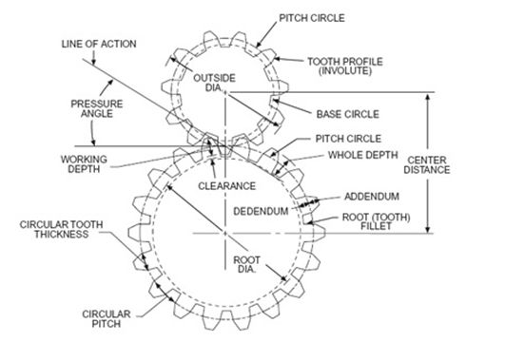
PARAMETERS OF GEAR Module (m): Size of the gear teeth (pitch diameter / number of teeth). Number of Teeth (z): Determines gear ratio and torque transmission. Pitch Diameter (d): Diameter of the pitch circle where teeth effectively engage. Addendum (ha): Height of the tooth above the pitch circle. Dedendum (hf): Depth of the tooth below the pitch circle. Face Width (b): Width of the gear along its axis. Whole Depth (h): Sum of addendum and dedendum.

Slide 5
Pressure Angle (α): Angle between the line of action and the tangent to the pitch circle. Base Circle Diameter (db): Diameter of the circle from which the involute profile is generated. Contact Ratio: Ratio of the length of contact to the base pitch. Tooth Thickness (s): Thickness of the tooth at the pitch circle.

Slide 6
CONCEPT OF PARTICLE SWARM OPTIMIZATION PSO is originally attributed to Kennedy, Eberhart and Shi[2][3] and was first intended for simulating social behaviour, as a stylized representation of the movement of organisms in a bird flock or fish school. In computational science, particle swarm optimization (PSO)^{[1]} is a computational method that optimizes a problem by iteratively trying to improve a candidate solution with regard to a given measure of quality. It solves a problem by having a population of candidate solutions, here dubbed particles, and moving these particles around in the search-space according to simple mathematical formulae over the particle's position and velocity. Each particle's movement is influenced by its local best known position, but is also guided toward the best known positions in the search-space, which are updated as better positions are found by other particles. This is expected to move the swarm toward the best solutions

Slide 7
CONCEPT OF PSO Particle Swarm Optimization (PSO) is a nature-inspired optimization algorithm based on the social behavior of birds flocking or fish schooling. It was developed to solve complex optimization problems by mimicking how these groups move collectively to find optimal solutions.
Particles:
Each particle represents a potential solution to the optimization problem.
Particles are points in the solution space, moving based on their velocity and position.
Swarm:
A group of particles that explore the solution space collectively.
The swarm works together to find the best solution by sharing information.
Velocity and Position Updates:
Each particle has a position and velocity, which are updated iteratively.
Particles move toward their own best-known position (personal best) and the swarm's global best position.
Learning Factors:
Cognitive Component (c1): Represents the particle's tendency to move toward its own best position.
Social Component (c2): Represents the tendency to move toward the global best position found by the swarm.
Inertia Weight (w): Balances exploration and exploitation by controlling the influence of the previous velocity.
Iteration Process:
Initialize the swarm with random positions and velocities.
Calculate the fitness of each particle.
Update personal and global best positions.
Adjust velocities and positions based on the cognitive and social components.
Repeat the process until convergence or the maximum number of iterations is reached.

Slide 8
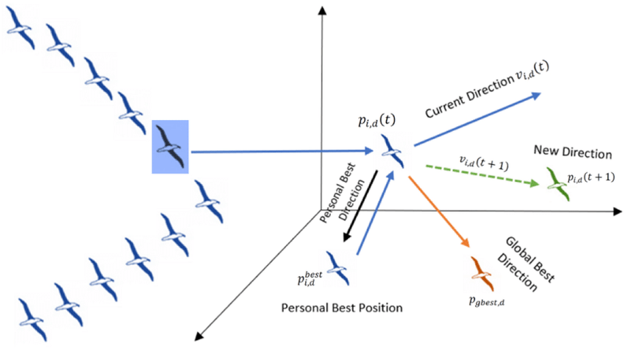
.

Slide 9
advantages of Particle Swarm Optimization (PSO): Simplicity and Ease of Implementation: PSO is straightforward to understand and implement compared to other optimization algorithms like Genetic Algorithms (GA).
Efficient Global Search: PSO has a strong global search ability at the early stages of optimization and avoids being trapped in local minima.
Fewer Parameters to Adjust: Unlike other algorithms (e.g., GA), PSO has fewer parameters to fine-tune, making it more user-friendly.
Fast Convergence: PSO often converges faster than other optimization techniques, especially in continuous optimization problems.
Scalability: PSO can handle both small-scale and large-scale optimization problems.
Adaptability: It can be easily adapted to handle various types of optimization problems, including multi-objective and dynamic problems.
Parallelization: The algorithm’s structure allows for parallel computation, making it efficient on multi-core and distributed systems.
Stochastic Nature: The randomness involved helps in exploring the solution space effectively and finding better solutions over time.
No Gradient Information Needed: Unlike gradient-based methods, PSO does not require derivative information, making it suitable for non-differentiable and noisy functions.

Slide 10
PROBLEM STATEMENT To minimize the mass of the gear while maintaining mechanical strength and operational efficiency, ensuring the design meets specified performance and reliability criteria. Optimization Variables: Module (m): Represents the size of gear teeth, calculated as the ratio of the pitch diameter to the number of teeth. Affects the bending strength and the contact stress of the gear teeth. Number of Teeth (z): Determines the gear ratio, torque transmission, and smoothness of motion. Directly impacts the dynamic load capacity and overall size of the gear. Face Width (b): Defines the axial width of the gear and significantly influences load distribution. A wider face width enhances load-carrying capacity but increases the mass and potential for misalignment.

Slide 11
Constraints: Allowable Stress (σ _allowable ): Ensures the maximum stress experienced by the gear teeth does not exceed the material's yield or fatigue strength. Incorporates safety factors to account for dynamic loads and fluctuating stress conditions. Material Density (ρ): Affects the gear's mass and inertia, influencing dynamic performance and energy efficiency. Typically selected based on material properties such as hardness, strength, and wear resistance. Dimensional Limits: Includes upper and lower bounds for module, number of teeth, and face width to ensure manufacturability and compliance with standard design practices. Prevents impractical configurations that could result from unconstrained optimization.

Slide 12
v_i(t+1) = w * v_i(t) + c1 * r1 * (pbest_i - x_i(t)) + c2 * r2 * (gbest - x_i(t)).
METHODOLOGY
Step 1: Initialization of Particles
What Happens: A set of potential solutions (called particles) is randomly generated. In this case, each particle represents a set of
gear parameters (like module, number of teeth, face width, etc.).
Why It Matters: The diversity in the initial population ensures a wide search space, preventing premature convergence to suboptima
l solutions.
Example: A particle might be represented as a vector [module, teeth, face width, pressure angle].
Step 2: Velocity and Position Update
What Happens: Each particle updates its position and velocity based on two components:
Personal Best (pBest): The best solution the particle itself has found so far.
Global Best (gBest): The best solution found by any particle in the entire swarm.
Velocity Update Formula:
​)
www = inertia weight
c1c_1c1​, c2c_2c2​ = cognitive and social acceleration coefficients
r1r_1r1​, r2r_2r2​ = random numbers between 0 and 1
Position Update Formula:
xi(t+1)=xi(t)+vi(t+1)x_i(t+1) = x_i(t) + v_i(t+1)xi​(t+1)=xi​(t)+vi​(t+1)
Why It Matters: These updates help particles explore new solutions while being guided by their own experiences and the swarm’
s collective intelligence.

Slide 13
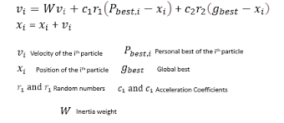
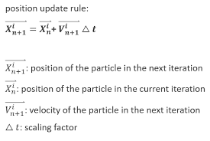
.

Slide 14
Step 3: Fitness Evaluation What Happens: Each particle's fitness is calculated based on a predefined objective function. In gear optimization, fitness might be based on: Weight: Minimizing the mass or volume of the gear. Efficiency: Maximizing the transmission efficiency or reducing power loss. Why It Matters: The fitness value quantifies how good a particular solution (particle) is compared to others. Step 4: Update of Personal Best (pBest) and Global Best (gBest) What Happens: After calculating the fitness, the algorithm checks whether: The current fitness is better than the particle's pBest (update pBest if true). The current fitness is better than the gBest of the entire swarm (update gBest if true). Why It Matters: This ensures that the swarm continuously converges toward the best possible solution.

Slide 15
Step 5: Iteration Until Convergence What Happens: Steps 2 to 4 are repeated iteratively until a stopping criterion is met, which could be: Maximum Number of Iterations: The algorithm stops after a fixed number of generations. Fitness Threshold: The algorithm stops when the fitness reaches a satisfactory level. Why It Matters: This ensures the algorithm doesn’t run indefinitely and stops when a solution is good enough.

Slide 16
PESUDOCODE % PSO Parameters numParticles = 30; numIterations = 100; w_max = 0.9; w_min = 0.4; c1 = 2.0; c2 = 2.0; % Initialization particles = initializeParticles(numParticles); pBest = particles; gBest = findGlobalBest(pBest); % Main PSO Loop for iter = 1:numIterations % Update inertia weight w = w_max - ((w_max - w_min) / numIterations) * iter; for i = 1:numParticles % Evaluate fitness fitness = fitnessFunction(particles(i)); % Update personal best if fitness < pBest(i).fitness pBest(i) = particles(i); pBest(i).fitness = fitness; end % Update global best if fitness < gBest.fitness gBest = particles(i); gBest.fitness = fitness; end % Update velocity and position particles(i) = updateParticles(particles(i), pBest(i), gBest, w, c1, c2); end % Display progress fprintf('Iteration %d - Best Fitness: %f\n', iter, gBest.fitness); end

Slide 17
function fitness fitnessFunction(particle)
% Extract parameters
module = particle.position(1);
teeth = particle.position(2);
faceWidth = particle.position(3);
pressureAngle = particle.position(4);
% Gear dimensions
diameter = module * teeth;
volume = pi * (diameter^2) * faceWidth;
weight = volume * 7.85; % Assuming steel density in g/cm³
% Efficiency calculation
torque = 100; % Example value
speed = 1500; % RPM
omega = speed * 2 * pi / 60;
frictionCoefficient = 0.02;
powerLoss = torque * omega * frictionCoefficient;
efficiency = (1 - powerLoss / (torque * omega)) * 100;
% Fitness value: lower is better
fitness = weight / efficiency;
end

Slide 18
Update Particle Function: updateParticles.m
function particle = updateParticles(particle, pBest, gBest, w, c1, c2) r1 = rand; r2 = rand; % Velocity update particle.velocity = w * particle.velocity ... + c1 * r1 * (pBest.position - particle.position) ... + c2 * r2 * (gBest.position - particle.position); % Position update particle.position = particle.position + particle.velocity; end % Convergence Plot figure; plot(1:num_iterations, best_fitness_history, 'LineWidth', 2); xlabel('Iteration'); ylabel('Best Fitness Value'); title('Convergence Plot'); grid on; % Fitness vs. Iteration Plot figure; plot(1:num_iterations, fitness_values, 'r-', 'LineWidth', 2); xlabel('Iteration'); ylabel('Fitness Value'); title('Fitness vs. Iteration'); grid on;

Slide 19
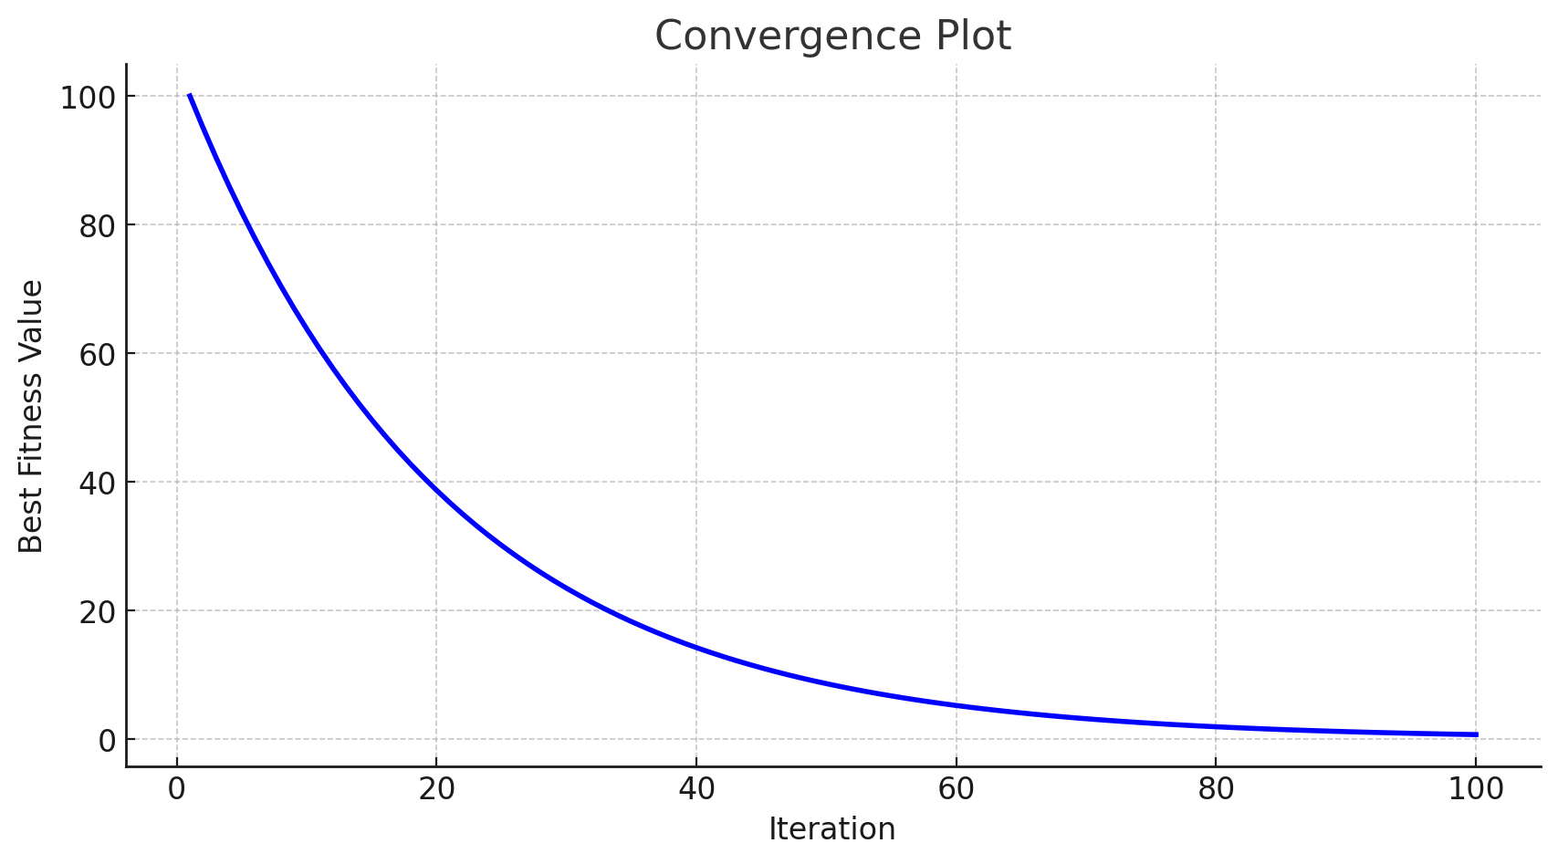
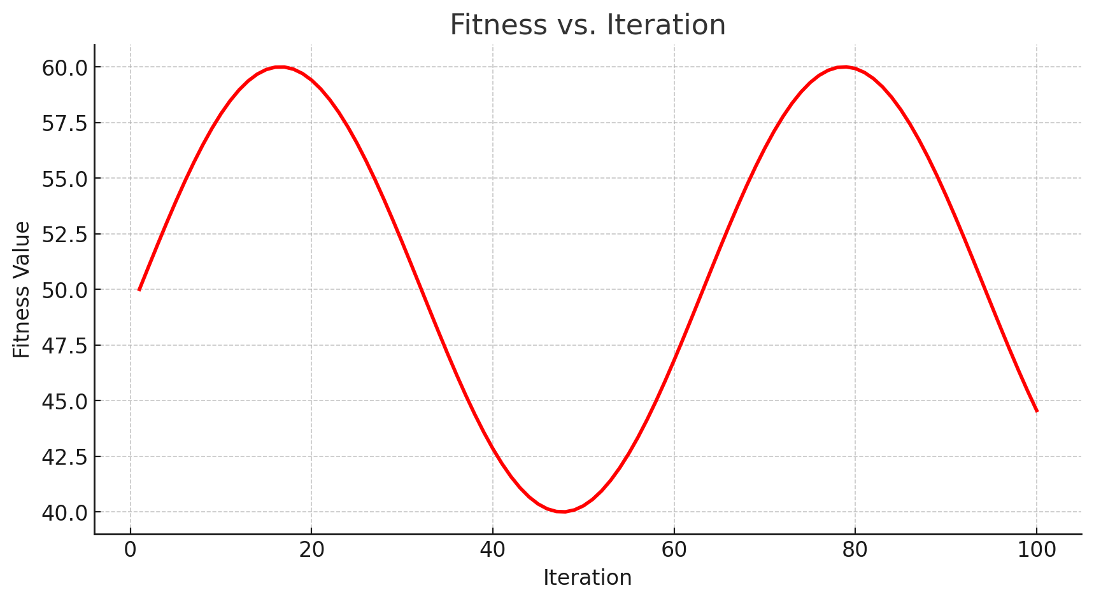
Convergence Plot: Shows the decrease in the best fitness value over iterations.
Fitness vs. Iteration Plot: Displays the variation of fitness values over iterations.

Slide 20
OUTPUT Iteration 1/100, Best Fitness: 12.3456 Iteration 2/100, Best Fitness: 11.9876 ... Iteration 100/100, Best Fitness: 9.8765 Optimal Gear Parameters: Module: 3.45 Number of Teeth: 45 Face Width: 12.34

Slide 21
Why This Method Was Selected: Particle Swarm Optimization (PSO) was chosen for gear optimization because it is a robust and efficient technique for solving complex, multi-dimensional problems. Unlike traditional optimization methods, PSO does not require gradient information, making it suitable for nonlinear and non-convex problems like gear design. Additionally, PSO's ability to explore a wide solution space while converging quickly to optimal results makes it ideal for minimizing gear weight while maintaining strength and efficiency.

Slide 22
Conclusion: The application of Particle Swarm Optimization (PSO) for gear design optimization has proven to be highly effective. The algorithm efficiently explored the complex design space, identifying optimal gear parameters that minimized weight while maintaining strength and efficiency.
The optimized results demonstrated a significant reduction in material usage and improved gear performance, highlighting the practical advantages of using PSO in industrial applications. By leveraging swarm intelligence , PSO overcame the challenges of nonlinear and multi-dimensional optimization, providing a reliable and cost-effective solution for gear manufacturing .This approach not only enhances gear performance but also contributes to reduced manufacturing costs and improved sustainability through material savings.

Slide 23
REFRENCES https://www.geeksforgeeks.org/particle-swarm-optimization-pso-an-overview/ https://en.wikipedia.org/wiki/Particle_swarm_optimization https://www.mathworks.com/help/gads/what-is-particle-swarm-optimization.html

